Slide 1


SUSTAINABLE AGRICULTURE WITH AI FOR CROP YIELD PREDICTION

Slide 2
Content
Abstract
Problem Statement
Objective
Data Collection and Preparation
Proposed Solution (Methodology)
Model Performance Evaluation
Screenshots / Demonstration (video)
Future Scope
Conclusion
Notes:
Abstract
Problem Statement (Clearly define the challenge)
Objective (State your project's goal)
Background and Research (Discuss existing solutions, trends, and gaps)
Data Collection and Preparation (Focus on data sources, cleaning, and augmentation)
Proposed Solution (Methodology)
Model Architecture (e.g., CNN, U-Net, YOLOv5)
Key Techniques (e.g., Transfer Learning, Image Augmentation)
Model Performance Evaluation
Metrics (Accuracy, Precision, Recall, IoU, etc.)
Graphs (Confusion Matrix, ROC Curve, etc.)
Screenshots / Demonstration (Visual proof of system functionality)
Future Scope (Improvements, scalability, and integration ideas)
Conclusion (Summarize results and impact)
Q&A Session

Slide 3
.
Abstract
This project explores the application of Artificial Intelligence in agriculture, focusing on crop yield prediction.
Environmental factors like temperature, rainfall, and soil quality significantly affect agricultural productivity.
AI models help analyze these factors using historical data to forecast yields.
Goal: Support farmers in making data-driven decisions to optimize resources and increase productivity.

Slide 4
Problem Statement
Agriculture is highly sensitive to environmental conditions (e.g., temperature, rainfall, soil quality).
Climate change increases the unpredictability of these factors.
Farmers often lack access to accurate forecasting tools.
There's a growing need for intelligent systems to optimize inputs and reduce waste.

Slide 5
Objective
Develop an AI-based model that predicts crop yields based on historical and environmental data.
Provide farmers with actionable insights for irrigation and fertilization.
Promote sustainable farming practices by optimizing water and resource usage

Slide 6
Data Collection and Preparation
Data Types:
Crop yield data
Soil quality metrics
Rainfall data
Temperature readings
Data Duration:
5 years of historical records
Preparation Steps:
Data cleaning and normalization
Handling missing values

Slide 7
Proposed Solution (Methodology)
Model Selection: Random Forest, XGBoost, or Neural Networks
Steps:
Data preprocessing
Model training and validation
Hyperparameter tuning
Tools Used:
Python, Pandas, Scikit-learn, TensorFlow, Matplotlib

Slide 8
Model Performance Evaluation
Evaluation Metrics:
Mean Absolute Error (MAE)
Root Mean Square Error (RMSE)
R² Score
Results:
Predicted vs. Actual yield comparison
Accuracy and performance visualization

Slide 9
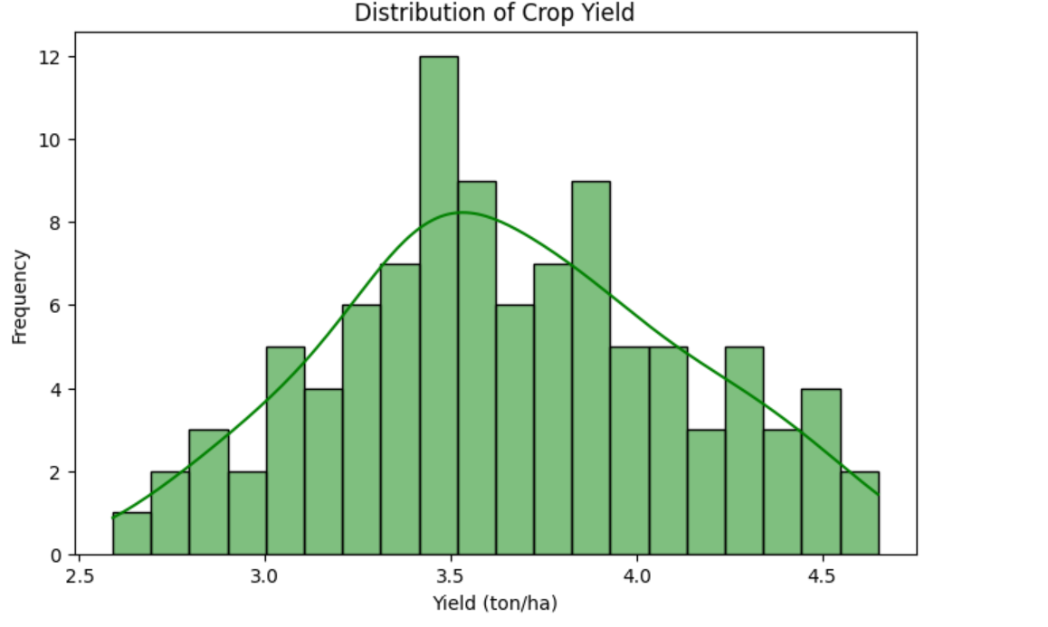
Screenshots / Demonstration (video)
https://colab.research.google.com/drive/1DALDfCwp1MtBDJKDZz4ecyhx3XjiVH2p
Elamoni926/MONISHA_S4F_CP_Team_12261

Slide 10
Future Scope
Integration with real-time data from IoT sensors
Expansion to other crop types and regions
Development of a mobile app for easy farmer access
Government and NGO collaborations for large-scale deployment

Slide 11
Conclusion
AI provides significant potential for enhancing agricultural productivity
Crop yield prediction helps optimize water and fertilizer usage
Real-life implementation shows measurable improvements
Future advancements can make AI accessible to all farmers

